Slide 1
PCI DSS modular approach for F2F EMV mature environments
Colin Whittaker
Director and Founder

Slide 2
Agenda
Background and Rationale for a PCI DSS modular approach for F2F EMV mature environments – The “Approach”
Define relevant representative F2F EMV merchant environments and their appropriate module of PCI DSS control requirements
A proposed assessment framework

Slide 3
Background and Rationale

Slide 4

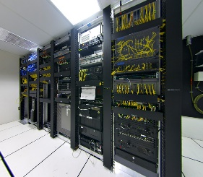

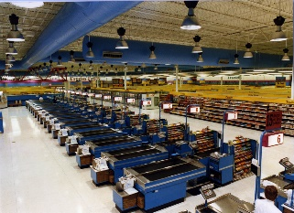

Traditional Approach to PCI DSS Scope
Acquirer
PCI DSS Scope
Merchant
Data Centre
E-Commerce
F2F
MOTO

Slide 5
Background to PCI DSS Compliance for
F2F Merchants
Pre 2011 - EMV iCVV issue and attacks against PIN Entry devices
Improvements in PIN entry device security
From 2008 - Attacks against F2F environments to capture mag-stripe data
2011 - Visa Europe Technology Innovation Programme
2012 – Early steps in a modular approach to PCI DSS Compliance

Slide 6


A Modular Approach by Channel
PCI DSS Scope
PCI DSS Scope
PSP
Acquirer
PSP
PCI DSS Scope
Merchant
Data Centre
E-Commerce
F2F
MOTO

Slide 7
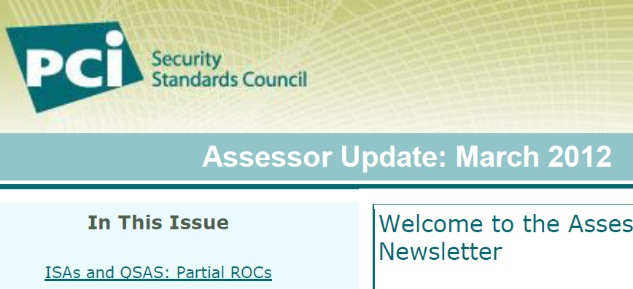
Initial Guidance for QSACs
An entity may only need to validate a subset of requirements to their acquirer
An entity may wish to validate a new security control that impacts only a subset of requirements
The entity offers a service which addresses only a limited number of PCI DSS requirements

Slide 8
Rationale for The Approach
Data has been Devalued
  Why ask EMV enabled F2F merchants to do more?
  Cardholder data breaches provide the evidence of the reduced threat to F2F EMV environments
Transparency and equivalence in payment systems a regulatory given for Europe
  PSD2
  MIF
Security standards must be appropriate to the value of the data being protected
  GDPR
Security a non-competitive issue

Slide 9
Factors The Approach had to Consider
Multi-channel payment acceptance
  What does adequate segmentation between channel look like?
Novel F2F Payment methods
  In store e-commerce
Small F2F merchants
  Recognise the limit of their capabilities to prove they are secure
Where cards are used for purposes other than payments
  Customer identification and verification
Skimming attacks
  Are they on the increase and if so why and does this change the approach?

Slide 10
Primary Assumptions
An EMV Mature Market can be defined
  >90% of card payments at F2F are made with EMV
  >95% of merchants are EMV enabled
  No evidence of any threat on EMV data since 2009
  There is an identifiable market wide community
  Acquirers & Issuers accept the residual risks to EMV
Sensitive Authentication Data must be redefined
  EMV track equivalent cardholder data should no longer be defined as sensitive authentication data

Slide 11
Rationale for excluding PCI DSS controls
Baseline: EMV F2F environments are stable and not subject to dynamic and frequent changes
Exclude processes and policies
Exclude derived amplifying requirements
Exclude controls which can be satisfied fully or in part by other controls
Exclude controls addressed by other PCI SSC standards
Partially retain some controls for key components

Slide 12
Example of Applying the Rationale
Fully Excluded
Partially Excluded
1.1.1 A formal process for approving and testing all network connections and changes to the firewall and router configurations
3.3 Mask PAN when displayed … such that only personnel with a legitimate business need can see more than the first six/last four digits of the PAN.
11.3.2 Perform internal penetration testing at least annually and after any significant infrastructure or application upgrade or modification
2.2 Develop configuration standards for all system components. Assure that these standards address all known security vulnerabilities and are consistent with industry-accepted system hardening standards.
11.2.1 Perform quarterly internal vulnerability scans. Address vulnerabilities and perform rescans to verify all “high risk” vulnerabilities are resolved in accordance with the entity’s vulnerability ranking (per Requirement 6.1). Scans must be performed by qualified personnel.

Slide 13
Representative F2F EMV merchant environments

Slide 14
Defined 3 types of merchants
Merchants which consolidate transactions (typically large retailers)
Merchants which connect directly to their Acquirer and contract a 3rd party service provider
Merchants which connect directly to the Acquirer

Slide 15
Common applicability requirements
The merchant must be in a EMV Mature market
Card acceptance devices must be a currently approved PTS device (PCI PTS2.0 or later as of today)
  Compliance to schemes sunset date policy
Other payment channels must be segregated at a network level from the EMV CDE,
  They must treat the EMV CDE as a less sensitive, and untrusted, environment

Slide 16
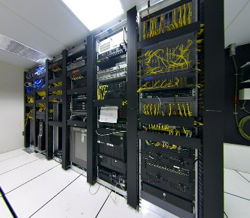
Merchant consolidates transactions
Acquirer
SAQ EMV Scope
Consolidation Server
Store A F2F
Store B F2F
……….
Store N F2F
Store N F2F
Store N F2F

Slide 17
SAQ EMV
45 out of 242 PCI DSS controls that need to be evidenced
11 of the 45 apply to the point of consolidation
  e.g.: 11.2.1 Perform quarterly internal vulnerability scans.
Burden of providing the evidence is passed to the acquirer and not the merchant
  e.g.: 4.1 Use strong cryptography and security protocols to safeguard sensitive cardholder data during transmission over open, public networks

Slide 18
PCI DSS Requirement 9.9
Protect devices that capture payment card data via direct physical interaction with the card from tampering and substitution
Proposed revised guidance:
  Requirements solely apply to the threat of device substitution and not tampering
  In attended environments substitution threats can be mitigated by technical means
  For unattended or semi-attended devices 9.9.2 and 9.9.3 always applies in all cases.

Slide 19
Good Practice Controls
7.1.2 Restrict access to privileged user IDs to least privileges necessary to perform job responsibilities
35 PCI DSS additional controls
No requirement to test against them
Provided for those who wish to enhance their security even further, eg:
  1.4 Install personal firewall software ……
  5.1 Deploy anti-virus software on all systems commonly affected by malicious software….
  7.1.2 Restrict access to privileged user IDs to least privileges ……
  11.4 Use intrusion-detection and/or intrusion-prevention techniques ……

Slide 20
Merchant connects directly to the Acquirer + 3rd party service provider
Service Provider
Acquirer
SAQ B-EMV Scope
Store A F2F
Store B F2F
……….
Store N F2F
Store N F2F
Store N F2F

Slide 21
SAQ B-EMV
Derived from SAQ B and SAQ B-IP
16 out of 242 PCI DSS controls that need to be evidenced
Applies to IP and dial-up connections
Additional applicability requirements:
  3rd parties have remote access to the EMV CDE
  The acquirer is responsible for the confidentiality requirements between them and the merchant
  The acquirer provides guidance on how to connect the device to the merchant’s network.

Slide 22
Merchant connects directly to the Acquirer
Acquirer
No PCI DSS Requirements
Store A F2F
Store B F2F
……….
Store N F2F
Store N F2F
Store N F2F

Slide 23
F2F EMV Accepting Merchants to whom PCI DSS no longer applies
Additional applicability requirements:
  There is no remote access to the EMV CDE
  The acquirer is responsible for the confidentiality requirements between them and the merchant
  The acquirer provides guidance on how to connect the device to the merchant’s network.

Slide 24
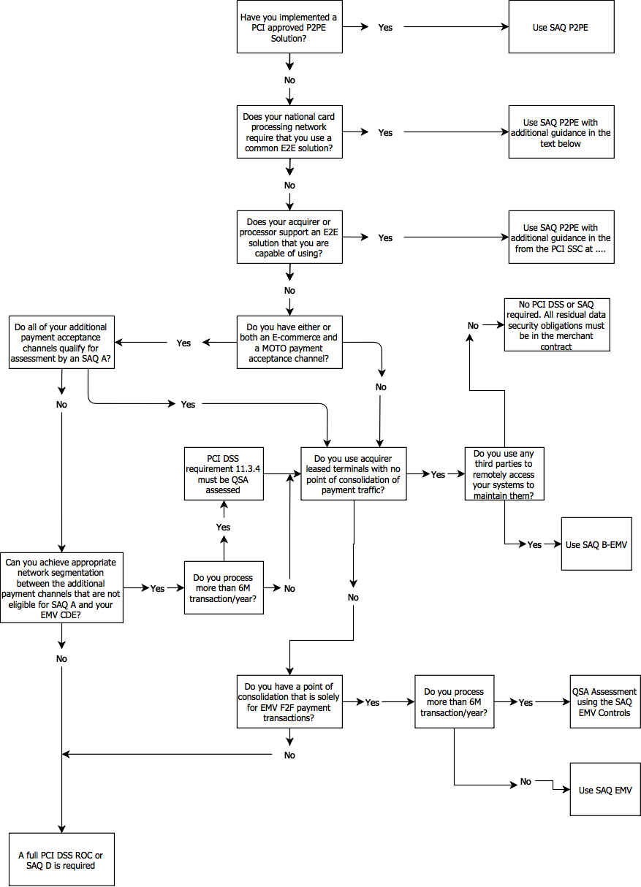
Scoping Flow Chart

Slide 25
Proposed assessment framework

Slide 26
Merchant Categories
Merchant consolidates transaction before submitting to an acquirer
Merchant retail outlet direct to acquirer
Large merchants processing more than 6M transactions per year
Multi-acceptance channel merchants
Multi-acceptance channel merchants who outsource non-EMV processing
Merchants have adopted a PCI validated P2PE solution
Merchants have implemented an end-to-end encryption (E2EE) solution

Slide 27
Levels of Assurance
PCI DSS
None
Self Assess
Self Assess
QSAC
Certify
QSAC
Increasing number of requirements
Merchant with direct connection to acquirer
Merchant with direct connection to acquirer + 3rd party service provider
Merchant consolidating transactions
“Level 1” merchants
non-modular approach
SAQ A-EP
SAQ C
SAQ B-IP
SAQ C-VT
TIP 2 Mandatory
SAQ EMV
SAQ B
SAQ P2PE
SAQ A
SAQ B-EMV
Increasing Assurance Requirements are satisfied

Slide 28
Common Assessment Framework
Merchant category | <6M Transactions/year | >6M Transactions/year
Merchant consolidates transactions before submitting to an acquirer | SAQ EMV | SAQ EMV Self Assessed PCI QSA certified
Merchant retail outlet transactions direct to an acquirer | SAQ B-EMV | SAQ B-EMV
Merchant with multi-acceptance channels network segmentation assessment requirement | Self-assess PCI DSS requirement 11.3.4 between EMV acceptance CDE and other channels’ CDE | PCI QSA assess PCI DSS requirement 11.3.4 between EMV acceptance CDE and other channels’ CDE
Merchant uses a PCI SSC P2PE validated Solutions | SAQ P2PE | SAQ P2PE
Merchant uses a nationally endorsed or acquirer/processor approved E2EE solution | SAQ P2PE | SAQ P2PE
Merchants that fall outside these categories | Where an EMV F2F merchant cannot meet the eligibility requirements as set out for each of these SAQs the normal PCI DSS scoping and compliance considerations apply

Slide 29
Concluding Remarks

Slide 30
Concluding Remarks
A significant change to PCI DSS compliance requirements for the F2F EMV environment
Assumes a common compliance assessment framework across all global card brands
  Under GDPR an alternative to this is possible
Do the merchant categories make sense?
Is QSA based assessment a burden?
  Would there be benefits in a QSAC certifying a self assessment?

